Slide 1


Course: Data Structure​
(Course Code : ETCCDS202)​
​
UNIT-1: Foundations of Data Structures​
Dr. Shahjad, Mr. Deepak, Neetu Ma’am​
School of Engineering & Technology
K.R. Mangalam University
Notes:
New Courses replaced with New Programmes

Slide 2

SESSION 5
Common Time Complexities
Notes:
New Courses replaced with New Programmes

Slide 3
Recapitulation (Previous Session)
Asymptotic analysis evaluates algorithm efficiency by measuring growth
in time and space
with increasing input size,
independent of machine factors,
using Big-O (worst case),
Big-Ω (best case),
and Big-Θ (tight bound)
to compare best, average, and worst behaviors and select the most efficient algorithm.
Notes:
New Courses replaced with New Programmes

Slide 4
Test Your Knowledge
1. What is the value of N0 in Asymptotic Notation?
2. What is the Value of N in the asymptotic notation?
3. Is Time complexity can be in negative form?

Slide 5
Time Complexity of an Algorithm
Time complexity: estimate of time taken by the algorithm
Time complexity is commonly estimated by counting the number of elementary operations, where each elementary operation takes a fixed amount of time to perform.
We use asymptotic notations for describing the time complexity of an algorithm.
We ignore hardware, operating system, processors, etc.

Slide 6
Space Complexity of an Algorithm
Space complexity : no. of memory units used w.r.t given input size.
For any algorithm memory may be used for the following:
Variables (This include the constant values, temporary values)
Program Instruction
Execution
Sometime Auxiliary Space is confused with Space Complexity. But Auxiliary Space is the extra space or the temporary space used by the algorithm during it's execution.
Space Complexity = Auxiliary Space + Input space

Slide 7
Common Time Complexities
O(1) is constant-time complexity. The number of operations for the algorithm doesn’t actually change as the problem size increases.
void Constant-Time(int arr[ ]) {
printf("First element of array = %d", arr[0]); }
This function runs in O(1) time (or "constant time") relative to its input.
A loop that runs a constant number of times is also considered as O(1).
for (int i = 1; i <= C; x++) // C is some constant
{ // some O(1) expressions }

Slide 8
Common Time Complexities
O(n): Linear-Time complexity
Running time increases at most linearly with the size of the input.
There is a constant c such that the running time is at most cn for every input of size n.
Linear time is the best possible time complexity in situations where the algorithm has to sequentially read its entire input.
void Linear-Time(int arr[])
{
printf("First element of array = %d",arr[i]);
}
This function runs in O(n) time, where n is the number of items in the array.

Slide 9
Common Time Complexities
O(n): Linear-time algorithm example
Examples
1. Traversing an array 2. Traversing a linked list 3. Linear Search 4. Deletion of a specific element in a Linked List (Not sorted) 5. Comparing two strings 6. Checking for Palindrome 7. Counting/Bucket Sort
Example of O(N)
int sum=0;
for (int i=0;i<n;i++)
{ Sum=sum +i, }
The running time is O(n)

Slide 10
Common Time Complexities
O(N²) time complexity
O(N²) - performance is directly proportional to the square of the size of the input data set.
Is common with algorithms that involve nested iterations over the input.
void Nsquare (int arr[], int size=N)
{
for (int i = 0; i < size; i++)
{
for (int j = 0; j < size; j++)
printf("%d = %d\n", arr[i], arr[j]);
}
}
If the array has 10 items, we have to print 100 times. If it has 1000 items, we have to print 1000000 times

Slide 11
Common Time Complexities
O(N²) time complexity
int count = 0;
for (int i = 0; i < N; i++)
for (int j = 0; j < i; j++)
count++;
The running time of statement inside the nested loop is product of size of loops.
for (i=0; i<n; i++)
for (j=0; j<k; j++)
a++;
The running time is O(n×k)
how many times count++ will run.
When i=0, it will run 0 times. When i=1, it will run 1 times. When i=2, it will run 2 times and so on.
Total number of times count++
will run is 0+1+2+...+(N−1)=N∗(N−1)/2.
So the time complexity will be O(N²).

Slide 12
Common Time Complexities
O(log n) is logarithmic complexity
Time Complexity of a loop is considered as O(Log n) if the loop variables is divided / multiplied by a constant amount.
for (int i = 1; i <=n; i *= c)
{ // some O(1) expressions }
for (int i = n; i > 0; i /= c)
{ // some O(1) expressions }
For example Binary Search has O(logn) time complexity.
The basic idea here is NOT using the complete data, and reducing the problem size with every iteration
The series that we get in first loop is 1, c, c², c³, … c^{k}. If we put k equals to Log_{c}n,
we get C^{Log}_{c}^{n} which is n.

Slide 13
O(log log n) Time Complexity
O(LogLogn) if the loop variables is reduced exponentially by a constant amount.
// Here c is a constant greater than 1
for (int i = 2; i <=n;i = pow(i, c))
{ // some O(1) expressions }
//Here fun is sqrt or cuberoot or any other constant root
for (int i = n; i > 0; i = fun(i))
{ // some O(1) expressions }

Slide 14
O(log n) VS O(log log n)
For example, let's take the number 65,536. How many times do we have to divide this by 2 until we get down to 1?
65,536 / 2 = 32,768
32,768 / 2 = 16,384
16,384 / 2 = 8,192
8,192 / 2 = 4,096
4,096 / 2 = 2,048
2,048 / 2 = 1,024
1,024 / 2 = 512
512 / 2 = 256
256 / 2 = 128
128 / 2 = 64
64 / 2 = 32
32 / 2 = 16
16 / 2 = 8
8 / 2 = 4
4 / 2 = 2
2 / 2 = 1
This process takes 16 steps, and it's also the case that 65,536 = 2¹⁶.
But, if we take the square root at each level, we get
√65,536 = 256
√256 = 16
√16 = 4
√4 = 2

Slide 15
Common Time Complexities
O(n³), O(n⁴), O(n⁵), etc. : polynomial complexity
O(2^{n}) : exponential complexity.
2⁵ | 32
2¹⁰ | 1024
2¹⁰⁰ | 1.2676506002282E+30
General ordering among functions.
O(1) < O(logn) < O( n) < O( n log n) < O(n*n) < O(n*n*n) < O(n^{k})< O(2^{n})

Slide 16
How to combine time complexities of consecutive loops?
When there are consecutive loops, we calculate time complexity as sum of time complexities of individual loops.
for (int i = 1; i <=m; i += c)
{ // some O(1) expressions }
for (int i = 1; i <=n; i += c)
{ // some O(1) expressions }
Time complexity of above code is O(m) + O(n) which is O(m+n)
If m == n, the time complexity becomes O(2n) which is O(n).

Slide 17
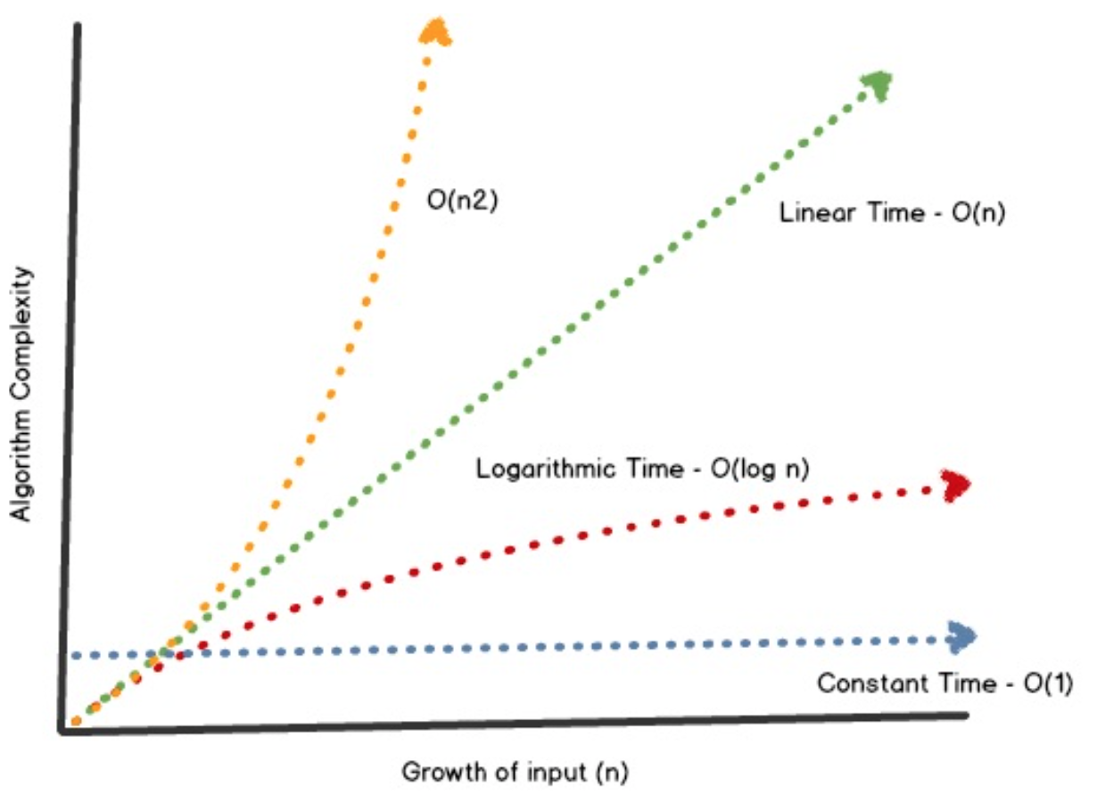
O(1),O(n), O(N²) VS O(log n) time complexities

Slide 18
Why worry about Complexity?
n | log₂n | n | nlog₂n | n² | n³ | 2^{n}
10 | 3.3 μs | 10 μs | 33 μs | 100 μs | 1 ms | 1 ms
10² | 6.6 μs | 100 μs | 664 μs | 10 ms | 1 s | 4×10¹⁶ years
10⁴ | 13 μs | 10 ms | 133 ms | 1.7 minutes | 11.6 days | 10²⁹⁹⁷ years
10⁶ | 20 μs | 1 s | 20 s | 11.6 days | 32000 years | 10³⁰⁰⁰⁰⁰ years
*Assuming one million operations per second
Important points to note:
O(logn) excellent complexity.
O(nlogn) is pretty good: hard to complain about it.
O(n^{k}) could be bad, depending on k
Ω(k^{n}) is a disaster.
If you have an algorithm with a higher complexity than necessary, no amount of clever programming will make up for it

Slide 19
QUIZ (Time Complexity)
What is the time, space complexity of following code:
int x = 0, y = 0;
for (i = 0; i < N; i++) {
x = x + rand();
}
for (j = 0; j < M; j++) {
y = y + rand();
}
Options:
O(N * M) time, O(1) space
O(N + M) time, O(N + M) space
O(N + M) time, O(1) space
O(N * M) time, O(N + M) space
Output:
3. O(N + M) time, O(1) space
The first loop is O(N) and the second loop is O(M). Since we don’t know which is bigger, we say this is O(N + M). This can also be written as O(max(N, M)).
Since there is no additional space being utilized, the space complexity is constant / O(1)

Slide 20
QUIZ (Time Complexity)
What is the time complexity of following code:
int c = 0;
for (x = 0; x < N; i++) {
for (y = N; y > x; y--) {
c = c + x + y;
}
}
O(N)
O(N*log(N))
O(N * Sqrt(N))
O(N*N)
Output:
4. O(N*N)
Explanation: The above code runs total no of times = N + (N – 1) + (N – 2) + … 1 + 0 = N * (N + 1) / 2 = 1/2 * N^2 + 1/2 * N O(N^2) times.

Slide 21
QUIZ (Time Complexity)
What does it mean when we say that an algorithm A is asymptotically more efficient than B?
Output:
2. A will always be a better choice for large inputs
Options:
A will always be a better choice for small inputs
A will always be a better choice for large inputs
B will always be a better choice for small inputs
B will always be a better choice for all inputs
Explanation: In asymptotic analysis we consider growth of algorithm in terms of input size. An algorithm A is said to be asymptotically better than B if A takes smaller time than B for all input sizes n larger than a value n0 where n0 > 0.

Slide 22
QUIZ (Time Complexity)
What is the time complexity of following code:
int a = 0, i = N;
while (i > 0) {
a += i;
i /= 2;
}
Options:
O(N)
O(Sqrt(N))
O(N / 2)
O(log N)
Output:
4. O(log N)
Explanation:
We have to find the smallest x such that
N / 2^x N x = log(N)

